Slide 1
MultiGlycan batch mode

Slide 2
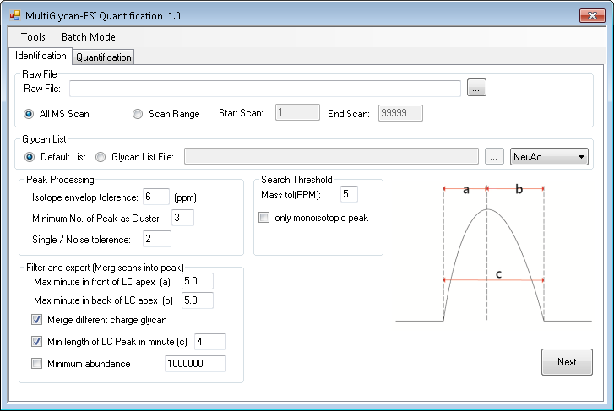

Slide 3
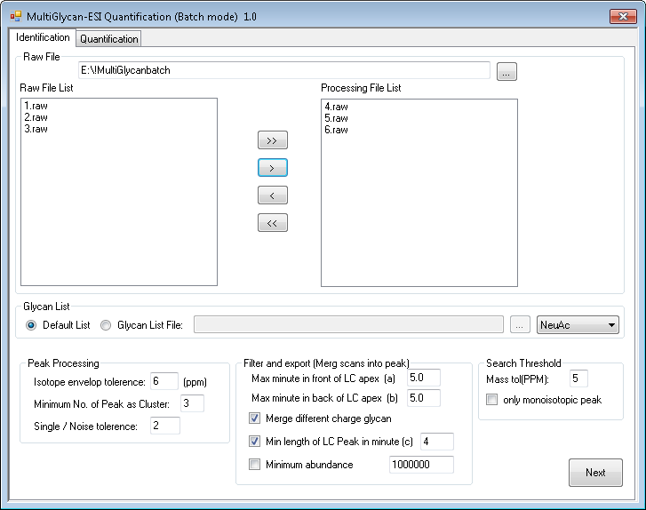
1. Browse raw file folder
2. Select files need to be processed
3. Move file to waiting list on the left

Slide 4
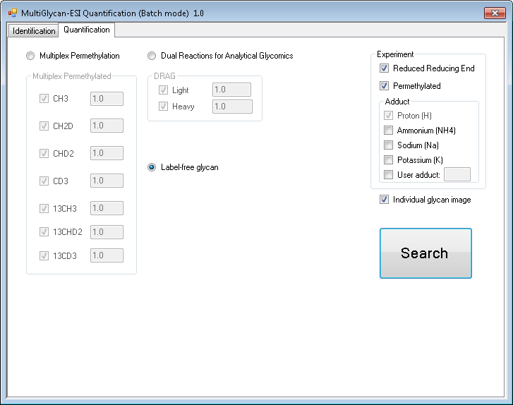

Slide 5
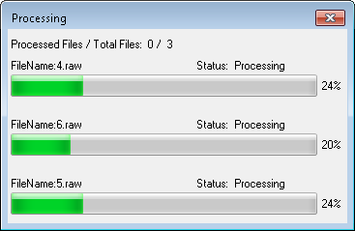
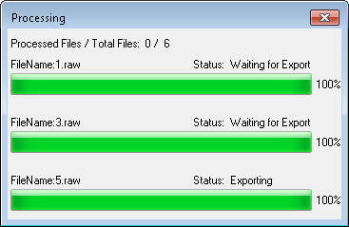
Processing three files concurrently
Only allow one file export result, the other two will wait (consume too many memory when generate the graph)

